Slide 1

DEPENDENCY FLOW VISUALIZER
Nitin Tewari

Slide 2
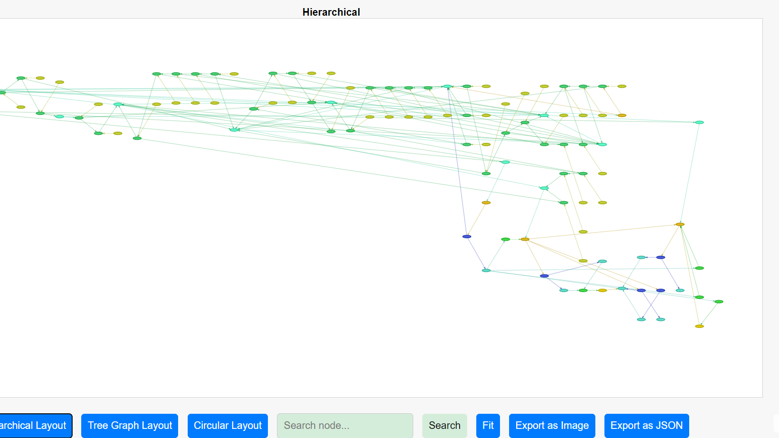
Overview
Dependency Flow Visualization is a powerful tool that enhances productivity. This presentation will explore various strategies and insights that can help by leveraging visualization techniques to optimize workflows and improve efficiency. Let’s delve into the transformative impact of visualizing job flows.

Slide 3
Benefits
Reduce analysis time
Easy visualization
Generates data

Slide 4
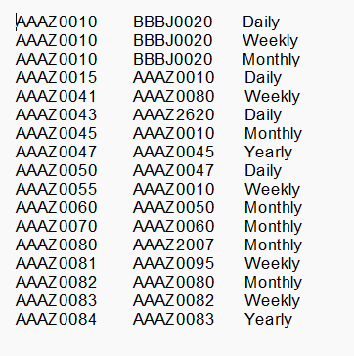
Input
The job scheduler/program dependency extract needs to be ingested as rows in the format ‘Job’, ‘Dependent Job’ & ‘Frequency’
Processing
Ingest data into the python module to generate HTML pages. Use JS, CSS, HTML to render the page.

Slide 5
Key Features
Analyse the dependencies in Hierarchical, Tree Graph and Circular layout.
Zoom and scroll as required.
Hover mouse over each node to get the details of predecessor and successor dependencies.
Click each node to open the source code in a new Tab.
Export the dependencies as JSON file for ingesting in another tool. Also take a screenshot of the graph at required levels.
Search the job name in the complex layout for closer look on the required job analysis.
Explore immediate dependencies, upstream, downstream and complete dependency path.
Identify different jobs cluster.
Colour coding and high lighting the dependencies for better visualization.

Slide 6
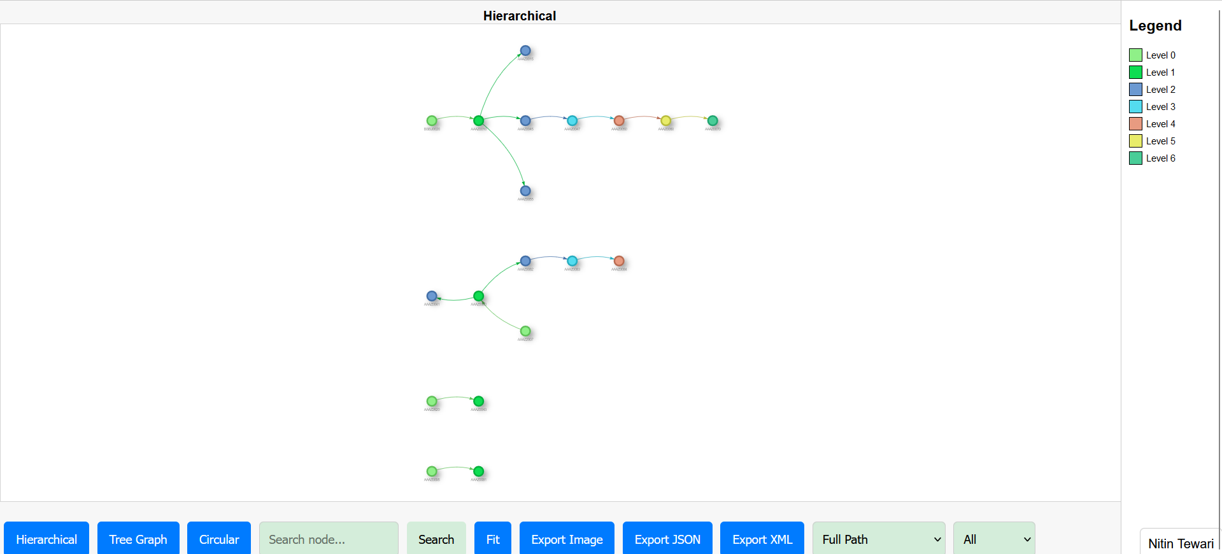
Key Layouts

Slide 7
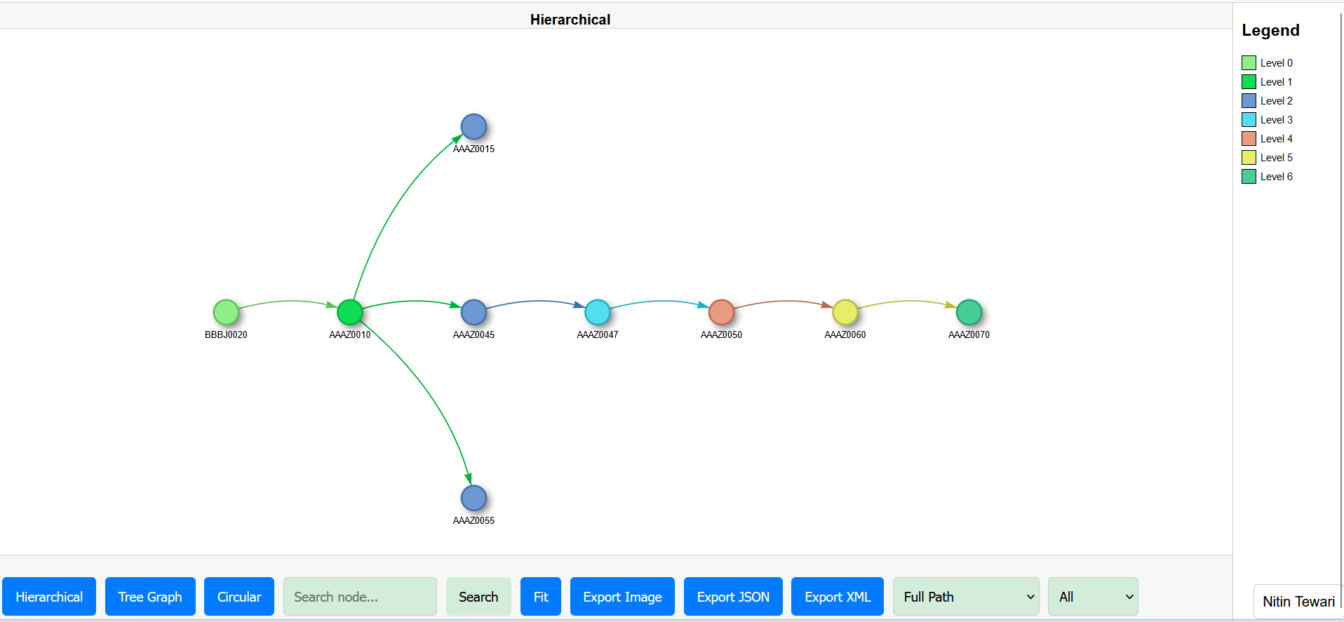
Key Layouts- Zoom/closer look

Slide 8

Key Layouts

Slide 9
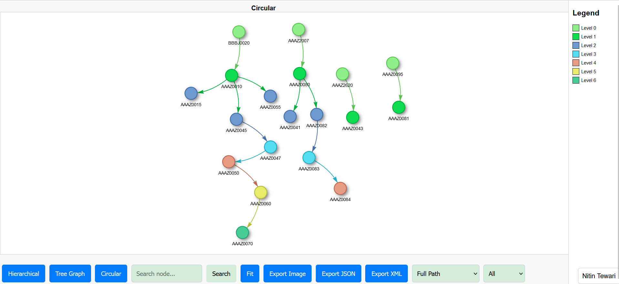
Key Layouts

Slide 10
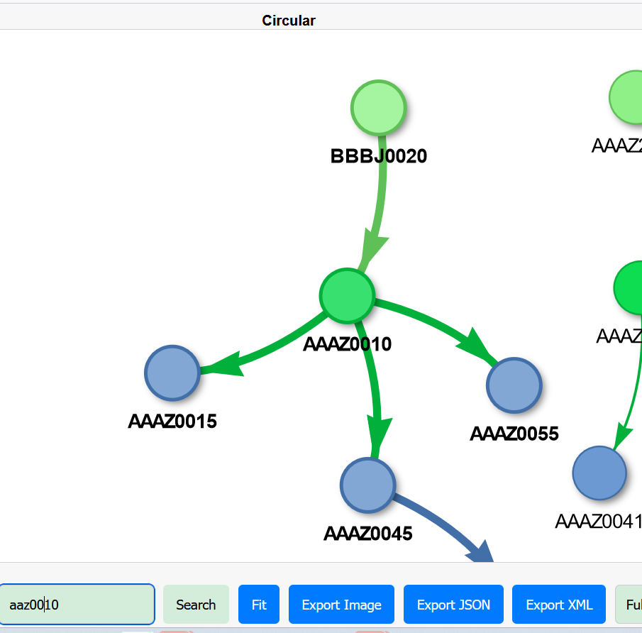
Search
Search the required job in the complex diagram.

Slide 11
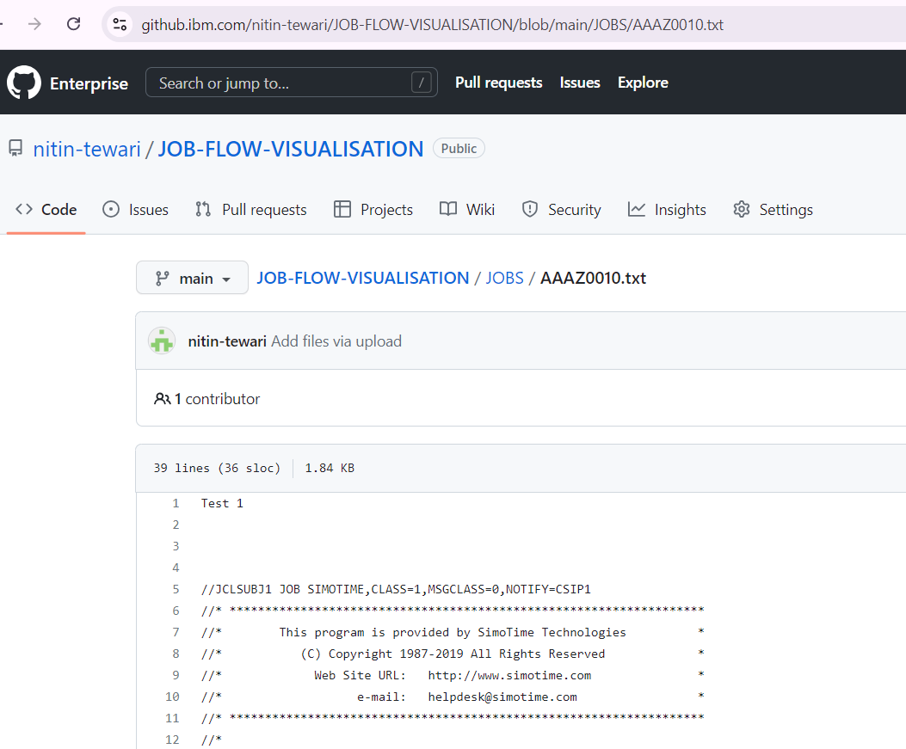
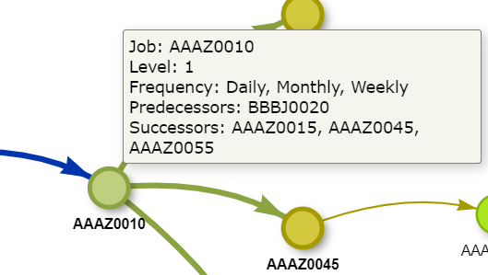
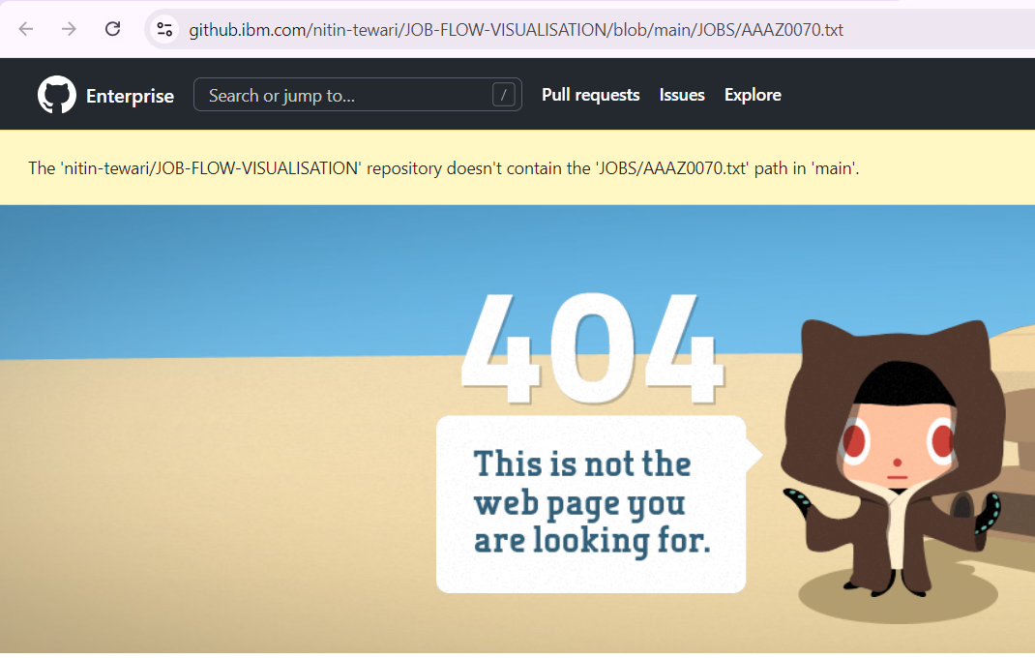
Get the source code of node: Double click the node and get the source code from specified location.
If source code is not available

Slide 12

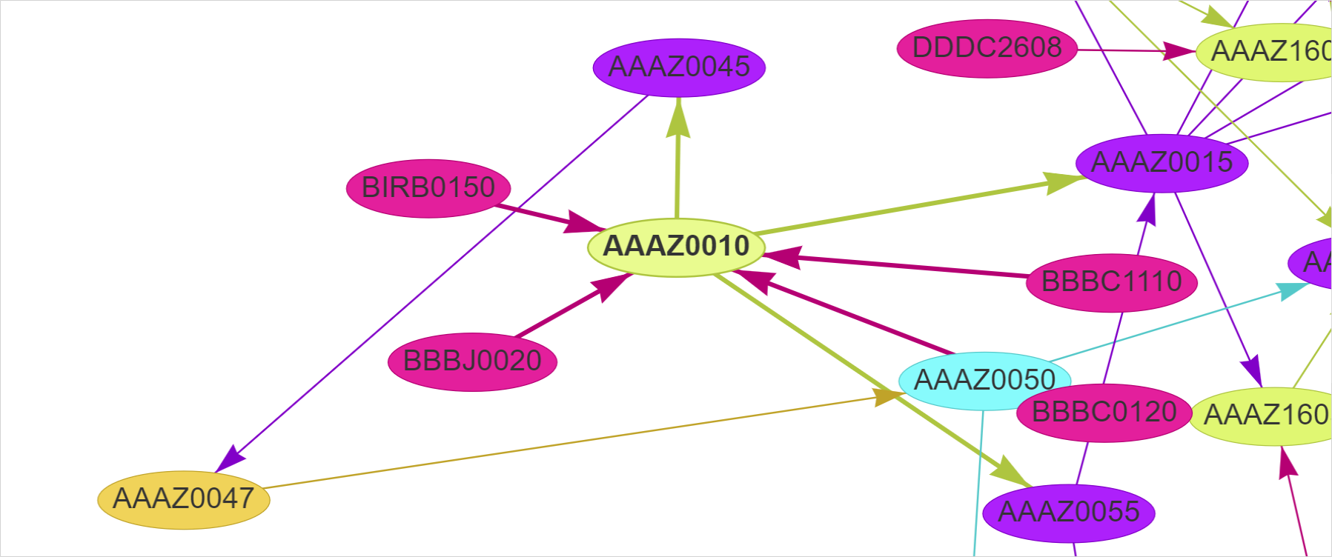
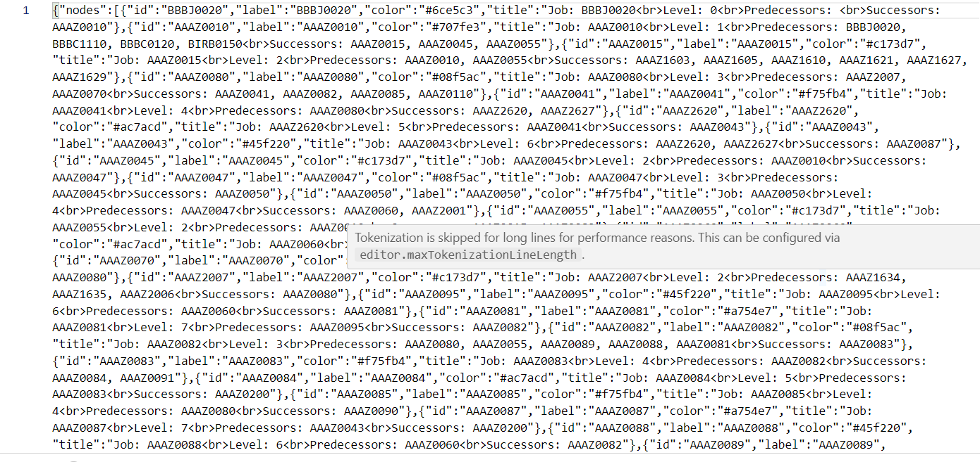
Export Dependencies: As Image, JSON & XML
Get the screenshot of the required job with dependencies.
Export job dependencies as JSON file for exporting to
other tools.
Image with no background

Slide 13
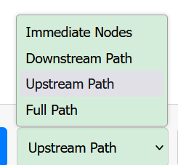
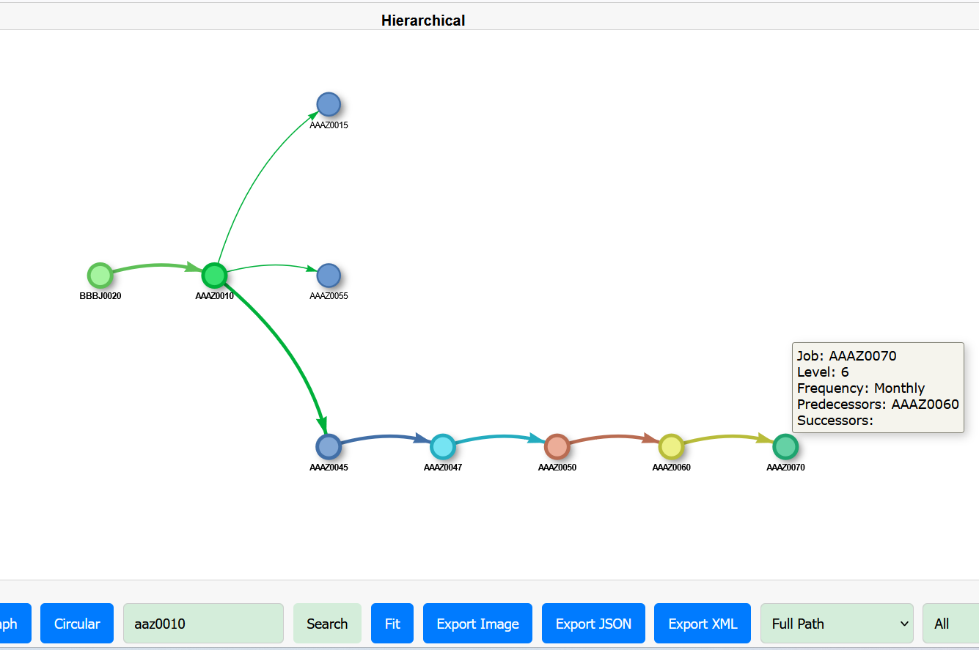
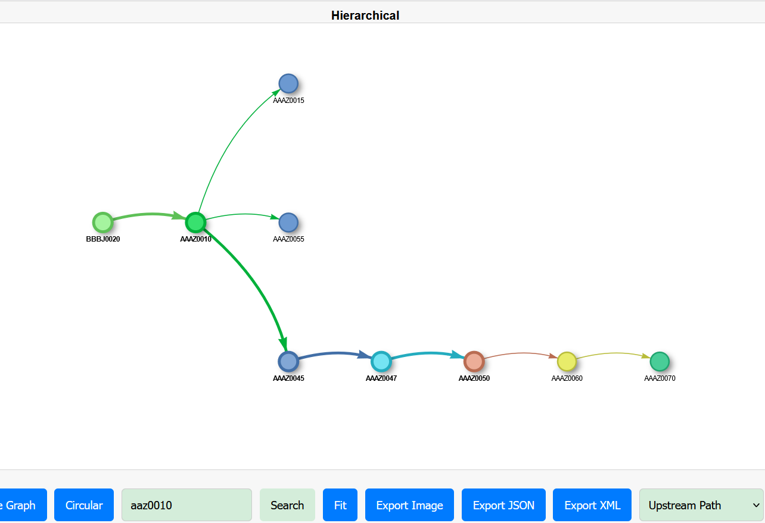
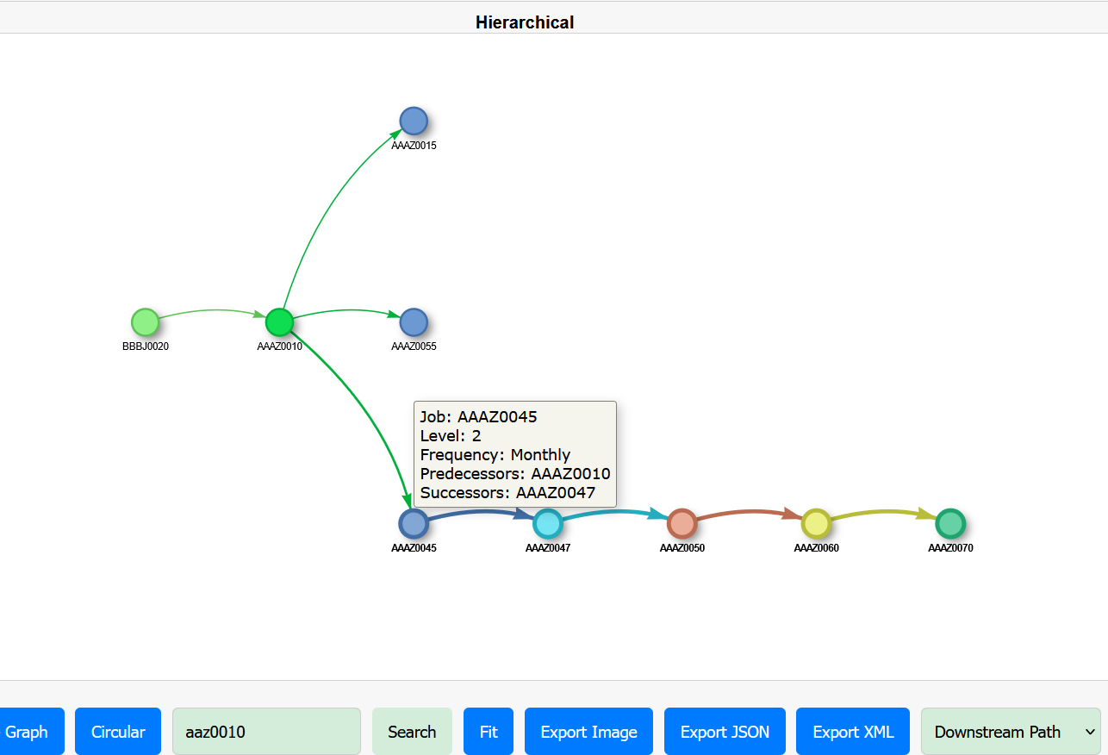
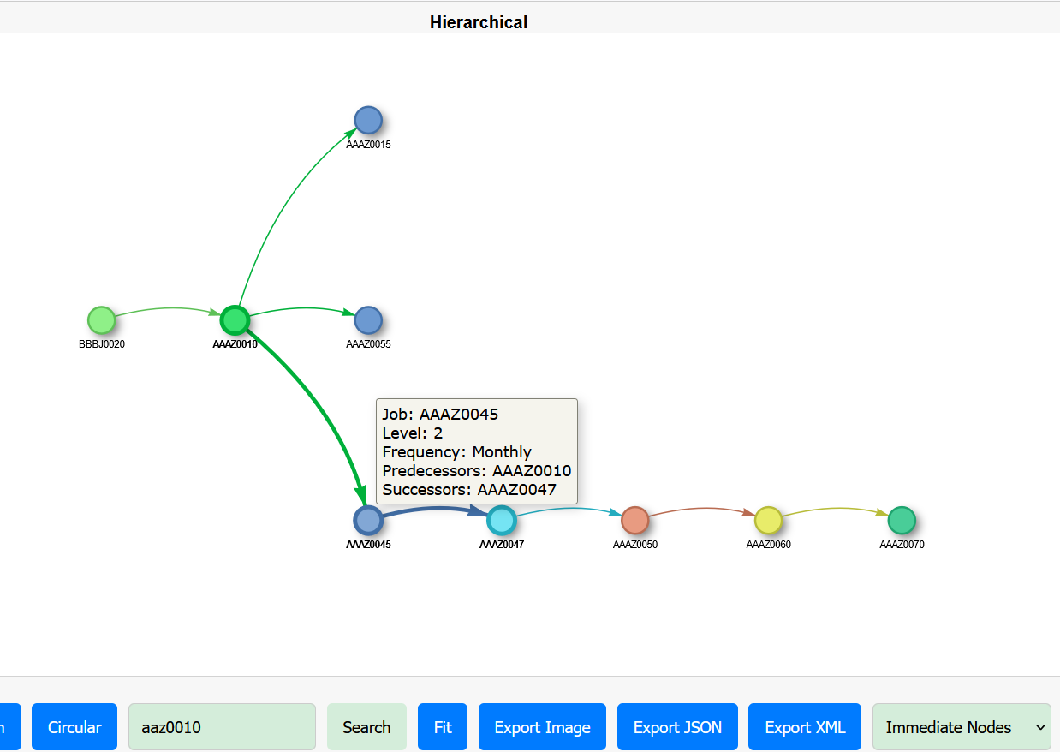
Explore Path

Slide 14
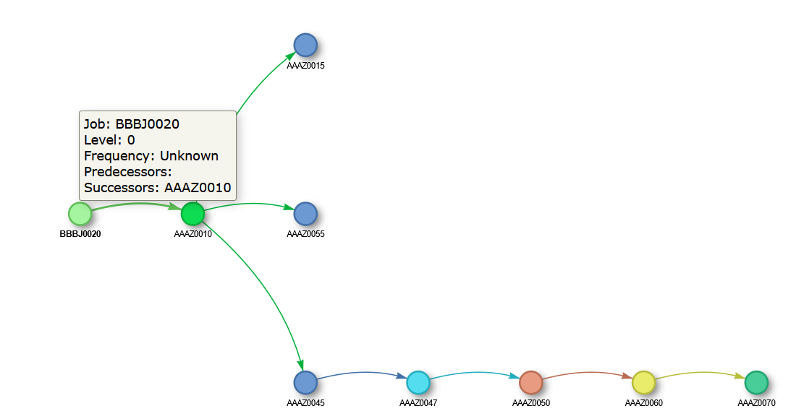
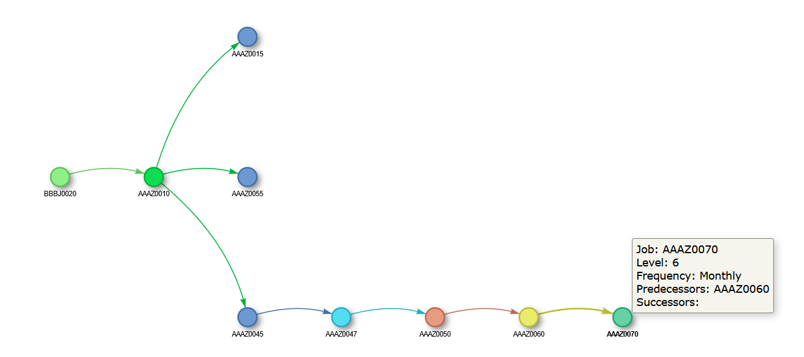
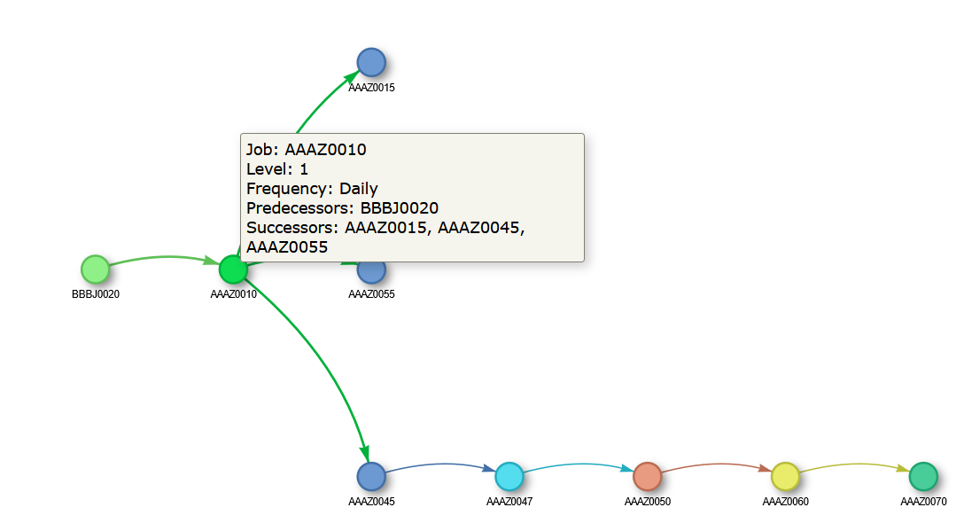
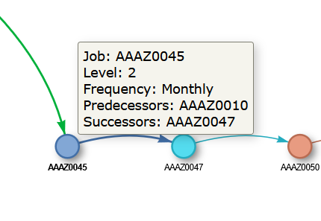
Get Details : Job, Level , Run Frequency, Predecessor, Successor

Slide 15
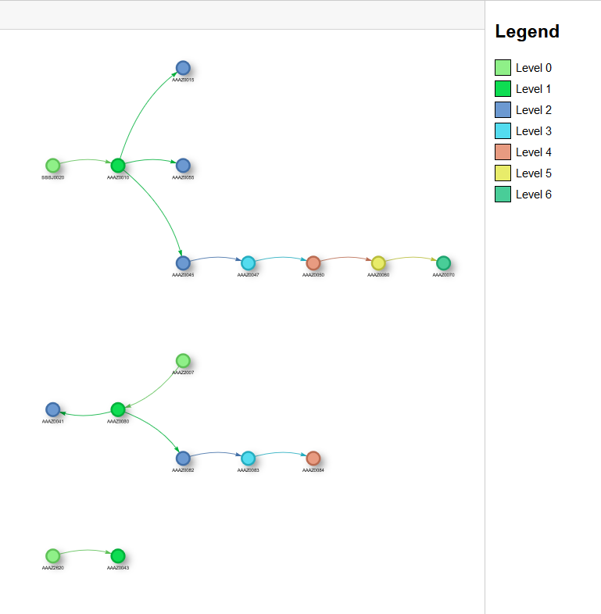
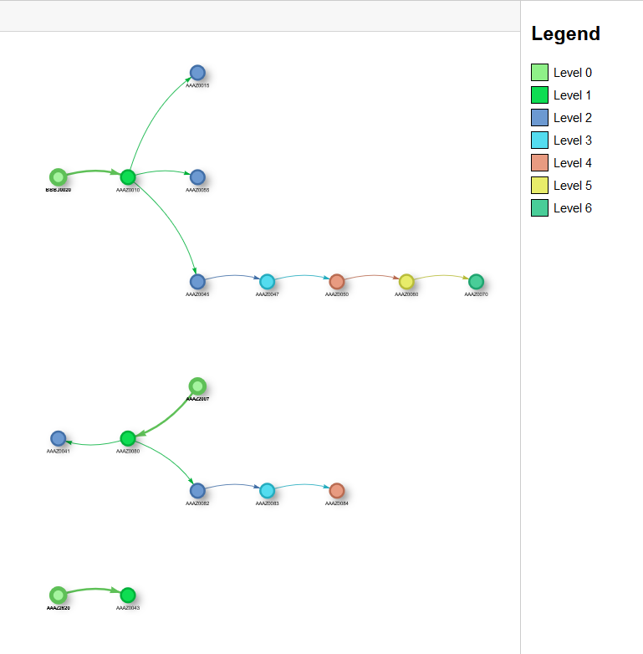
Highlight Dependency at specific level
Level 0

Slide 16
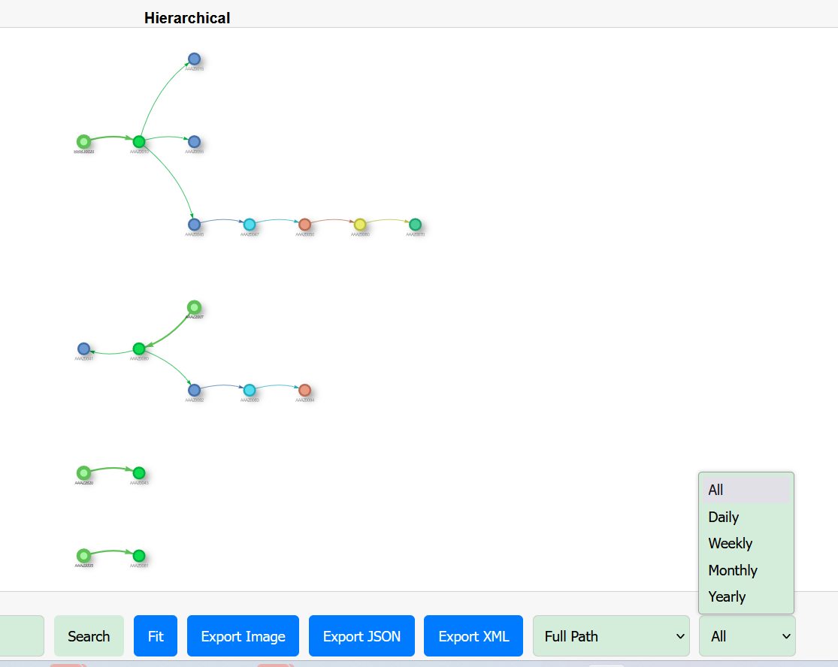
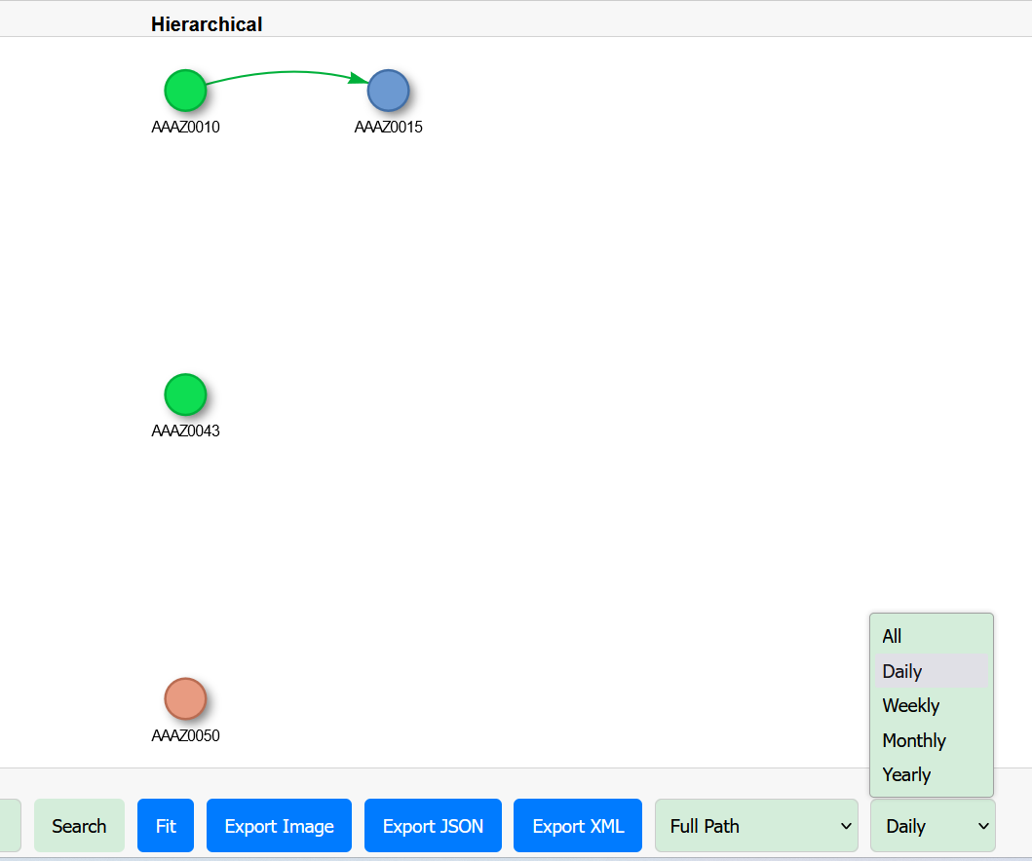
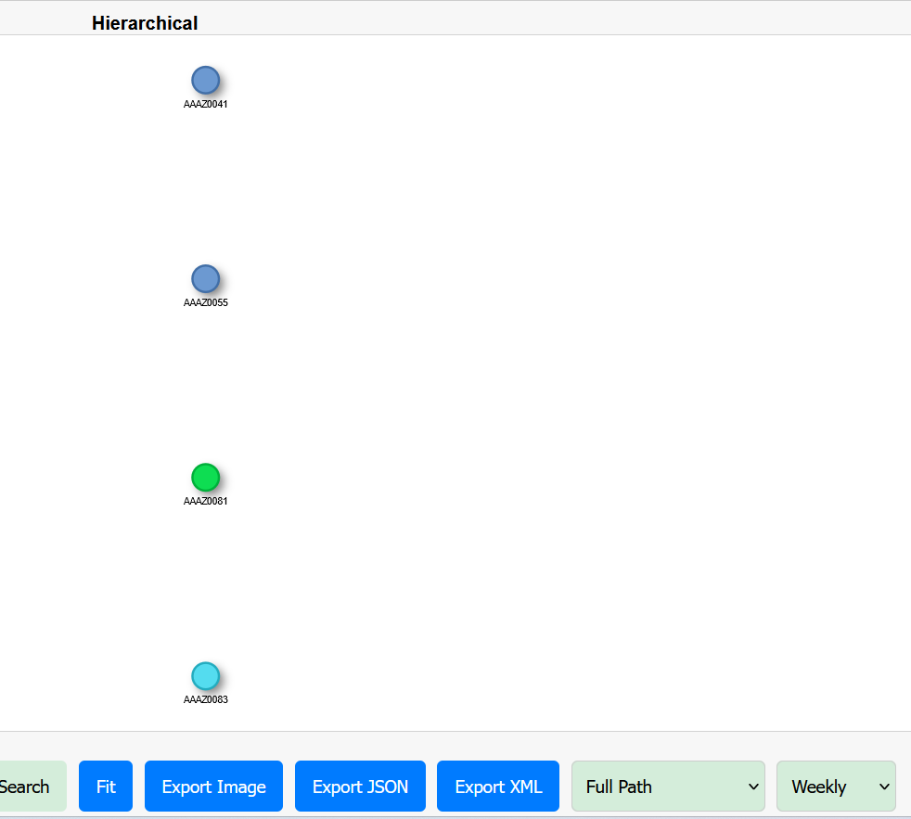
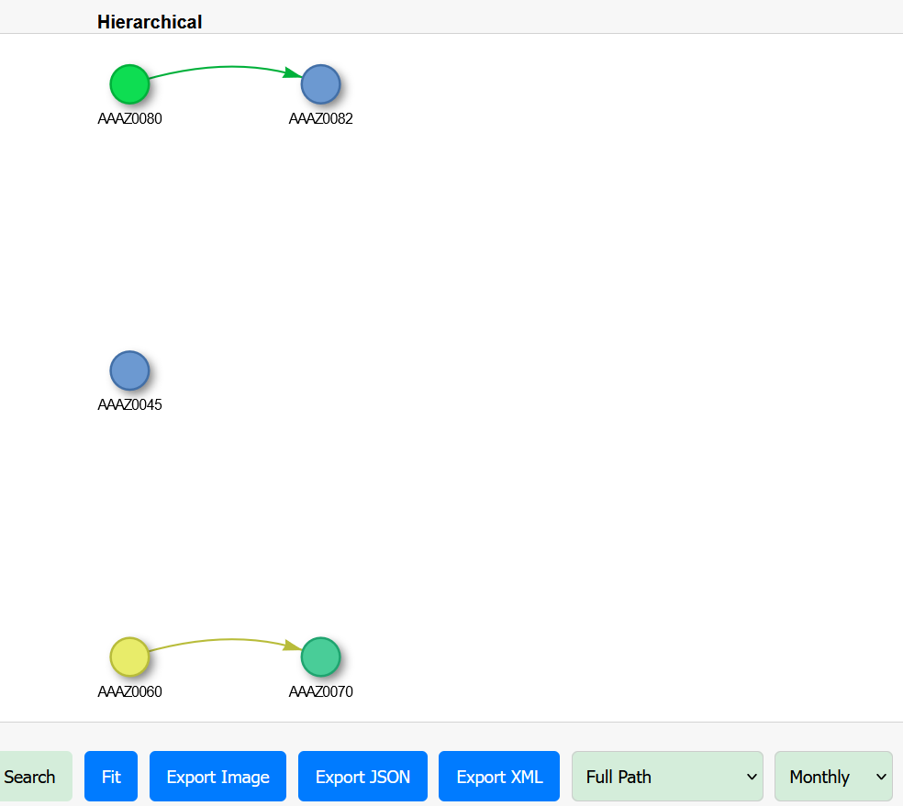
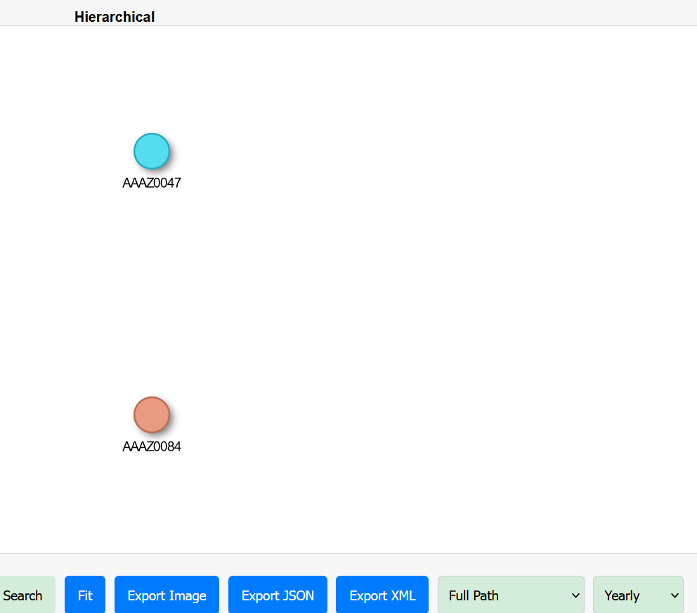
Filter by run frequency

Slide 17
Conclusion and Key Takeaways
Implementing visualization techniques can lead to numerous benefits, including improved decision-making. In conclusion, enhancing productivity through job flow visualization is not just beneficial but essential in today’s fast paced work environment.

Slide 18
Hope these capabilities excite you!
Thanks!
Do you have any questions?
Nitin Tewari

